Slide 1
Classless IP Addressing
(CIDR)

Slide 2
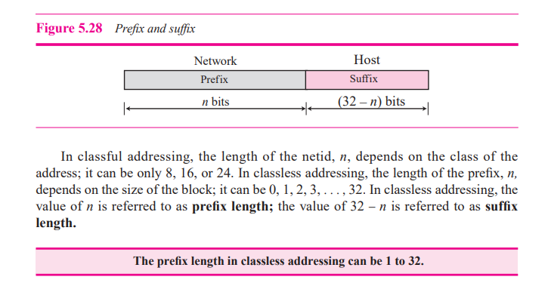

Slide 3
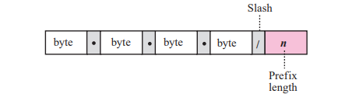
Slash Notation

Slide 4
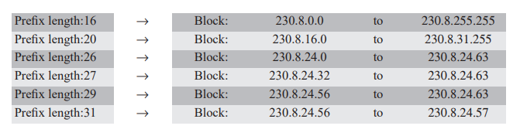
Slash Notation

Slide 5
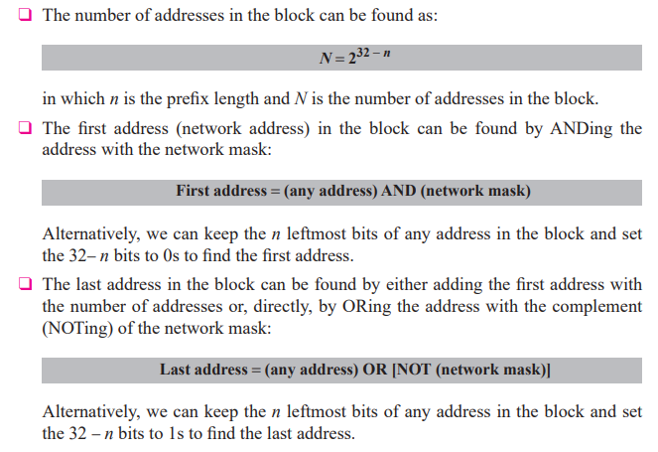

Slide 6

One of the addresses in a block is 167.199.170.82/27.
Find the number of addresses in the network, the first address, and the last address

Slide 7
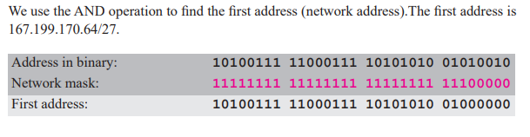
One of the addresses in a block is 167.199.170.82/27.
Find the number of addresses in the network, the first address, and the last address

Slide 8
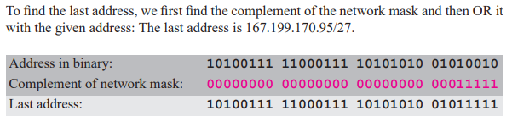
One of the addresses in a block is 167.199.170.82/27.
Find the number of addresses in the network, the first address, and the last address

Slide 9
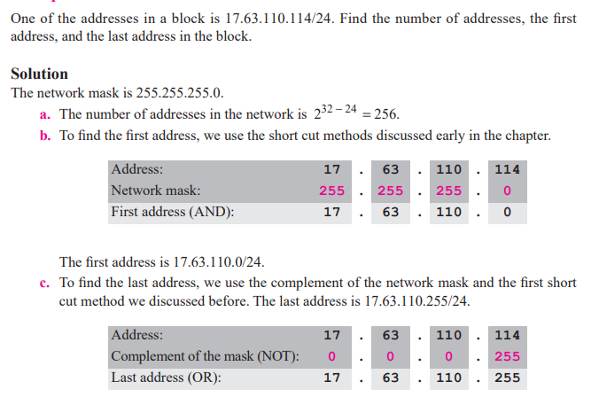

Slide 11
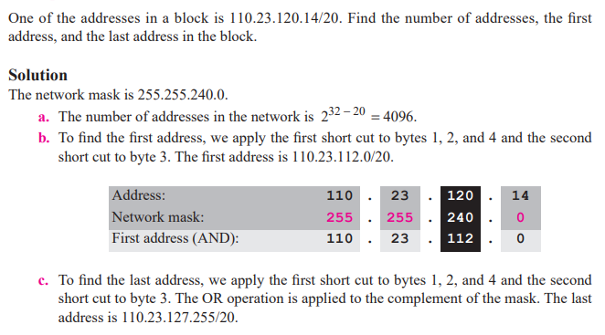

Slide 13


Slide 14
